Slide 1



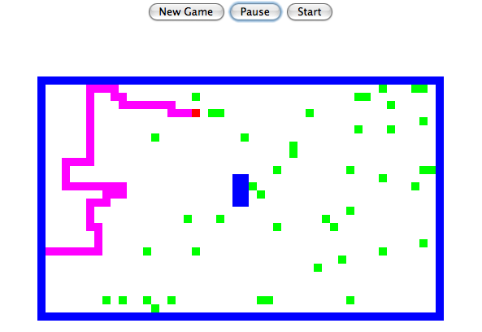
Today in CS 60
Software Engineering
strategies for software reuse
We support Green programming… 1995: Sun/Green/Oak/Java!
HW #6 Searching for SPAM, II
Spampede!
The gathering storm…
Wed., March 2 more Spampede
Mon., March 7 Threads (Hw6 due Tue. 3/8)
Fri., March 11 take-home midterm due
Spring Break!
Notes:
in the small … in the large!
gathering storm – assignment # 7

Slide 2
Strategy: Top-down design
Getting a clear view of the requirements of the project…
breaking it up into component pieces
visualize
reuse or recurse!
assembling those pieces into a coherent whole…
What will help with Spampede?

Slide 3
Top-down design
Getting a clear view of the requirements of the project…
breaking it up into component pieces
reuse or recurse!
assembling those pieces into a coherent whole…
What can we reuse for Spampede?
I need to upgrade!
Maze.java, v. 2.0
Needs accessors for data that other classes will be, well, accessing
Applets can't read files (ordinarily) - we'll need the maze in the code
More SPAM than ever before… we'll need a new strategy to get there!

Slide 4
mazeStrings
Specifying the maze within Maze.java …
private static final String[] mazeStrings = {
"**************************************************",
"*PS D *",
"* *",
"* *",
"* *",
"* *",
"* *",
"* *",
"* *",
"* *",
"* *",
"* *",
"* ** *",
"* ** *",
"* ** *",
"* ** *",
"* *",
"* *",
"* *",
"* *",
"* *",
"* *",
"* *",
"* *",
"* *",
"* D *",
"* *",
"* *",
"* *",
"**************************************************"
};
final ?
'S' == head of the centipede
'*' == wall
'D' == spam
'P' == body of the centipede
These are all just MazeCell contents…
How will BFS have to change to handle spam-finding?
50 columns
30 rows
Run!

Slide 5

final java notes
Avoid magic anything !
even Prof. Benjamin agrees...
data members used to give better names to values:
public static final char SPAM = 'D';
public static final char START = 'S';
public static final char WALL = '*';
public static final char PEDE = 'P';
unchangeable values for use in functions, etc. Preface with class name, if elsewhere!
These constants make code easier to read and modify, e.g.,
Maze.SPAM
BFS( start, SPAM );
but something looks wrong here

Slide 6
New maze methods
(1) multiBFS should find the nearest spam without changing the maze!
public MazeCell multiBFS(MazeCell start, char dest)
called as follows:
Why return a MazeCell?
multiBFS(start, SPAM)
for testing:
print the maze with the path, then remove the path before returning…
watch out!
other differences with respect to the old BFS?
what if… ?
testing: ascii demo
Notes:
other differences: the tail of the centipede the PEDE cells are like walls, too
what if: there is no solution!!

Slide 7
New maze methods
(1) multiBFS should find the nearest spam without changing the maze!
public MazeCell multiBFS(MazeCell start, char dest)
(2) accessor methods as needed…
(3) a new constructor (for mazeStrings)
/* method: constructor
* input: none
* output: a maze containing the data in mazeStrings, below
*/
protected Maze()
{
int HEIGHT = mazeStrings.length;
int WIDTH = mazeStrings[0].length();
this.maze = new MazeCell[HEIGHT][WIDTH];
for (int r=0 ; r<HEIGHT ; ++r) // for each row
for (int c=0 ; c<WIDTH ; ++c) // for each column
maze[r][c] = new MazeCell(r,c,mazeStrings[r].charAt(c));
}
This method is in the constructor-protection program. But you didn't hear it from me!
talk about warts!
not final
Software reuse strategy: copy-and-paste
(and test)!

Slide 8
Access Levels
Java has four levels at which data and methods can be accessed:
private
no access outside the defining class
protected
derived classes have access
classes in the same package have access
public
anyone can access the data or method
(package)

Slide 9
Access Levels
Java has four levels at which data and methods can be accessed:
private
no access outside the defining class
protected
derived classes have access
classes in the same package have access
public
anyone can access the data or method
(package)
/* method: constructor
* input: none
* output: a maze containing the data in mazeStrings, below
*/
protected Maze()
{
int HEIGHT = mazeStrings.length;
int WIDTH = mazeStrings[0].length();
this.maze = new MazeCell[HEIGHT][WIDTH];
for (int r=0 ; r<HEIGHT ; ++r) // for each row
for (int c=0 ; c<WIDTH ; ++c) // for each column
maze[r][c] = new MazeCell(r,c,mazeStrings[r].charAt(c));
}
Since we will want our zero-argument constructor to be called from an extension (a derived class) of Maze.
But not elsewhere…

Slide 10
Beyond copy-and-paste
Java is an object-oriented programming language:
Classes
Objects
user-defined datatypes
variables of those types
The primary goal of OOP is to create a good abstraction
- one that models relationships accurately
- without forcing the user to keep track of more than necessary
There are two relationship types that Java can model:
can it handle serious relationships?

Slide 11
Object-oriented programming
There are two basic relationship types that Java models:
Part-of
a QCell is “part of” a Queue
containment or embedding
a MazeCell is part of a Maze
a char (the contents) is part of a MazeCell
Kind-of
a String is a “kind of” an Object
specializations and extensions
a MazeCell is a kind of an Object
a SpamMaze is a Maze
^
a kind of
the empty relationship!
Notes:
last line is key … it's really extension!

Slide 12
Big Software Strategies
Reuse!
Embedding
Inheritance
using existing classes as data members
extending classes that are already written
Part-of
Kind-of

Slide 13
Embedding vs. Inheritance
What is it?
Data members…
Inheritance !
Models the “part of ” relationship among classes
Models the “kind of ” relationship among classes
Why would I want to?
Code reuse
Lets new code call old code
Code reuse
Lets old code call new code
Notes:
this week's new Maze class will use your Queue class from last week
this week's new SpamMaze class will use a linked list that someone else wrote years ago…!
you – or someone – wrote a linked list class… now let's use it as a data member (or two or more)…

Slide 14
Inheritance Hierarchy
Base Class
Data
Methods
Person
String name;
boolean isAsleep(int hr)
{
return hr > 22 || hr < 7;
}
Student
Derived Class
Very Derived Class
Mudder
(x'y - y'x) / y*y
Now that's derived!
Notes:
military-type definition of time…

Slide 15
Inheritance Hierarchy
Base Class
Data
Methods
Person
String name;
boolean isAsleep(int hr)
{
return hr > 22 || hr < 7;
}
Student
Derived Class
int units;
boolean isAsleep(int hr)
{
return hr > 2 && hr < 8;
}
overriding the previous method
Very Derived Class
Mudder

Slide 16
Inheritance Hierarchy
Base Class
Data
Methods
Person
String name;
boolean isAsleep(int hr)
{
return hr > 22 || hr < 7;
}
Student
Derived Class
int units;
boolean isAsleep(int hr)
{
return hr > 2 && hr < 8;
}
Very Derived Class
Mudder
String dorm;
??

Slide 17
What is this Java hierarchy missing?!
Inheritance Hierarchy
Base Class
Data
Methods
Person
String name;
boolean isAsleep(int hr)
{
return hr > 22 || hr < 7;
}
Student
Derived Class
int units;
boolean isAsleep(int hr)
{
return hr > 2 && hr < 8;
}
Very Derived Class
Mudder
boolean isAsleep(int hr)
{
return false;
}
String dorm;
Any further?
Notes:
add Object - the language's overarching base class for ALL user-defined and library-defined classes…
up: human, mammal, …
down: Case-ey; Casite; Casian; Caser; Case-ell, CS60er, Matt, Matt J

Slide 18
class Person
{
protected String name; // data member – protected
public Person( String name ) { this.name = name; }
public boolean isAsleep( int hr ) { return 22 < hr || 7 > hr; }
public String toString() { return name; }
public void status( int hr )
{
if ( this.isAsleep( hr ) )
System.out.println( "Now offline: " + this );
else
System.out.println( "Now online: " + this );
}
}
Inheritance Code
Base Class
Person
Super-Class
in main:
Person P;
P = new Person( "Wally" );
Consider a picture…
Notes:
draw a picture

Slide 19
class Person
{
protected String name; // data member – protected
public Person( String name ) { this.name = name; }
public boolean isAsleep( int hr ) { return 22 < hr || 7 > hr; }
public String toString() { return name; }
public void status( int hr )
{
if ( this.isAsleep( hr ) )
System.out.println( "Now offline: " + this );
else
System.out.println( "Now online: " + this );
}
}
Inheritance Details
Base Class
Person
Super-Class
class Student extends Person
{
protected int units; // additional data member
public Student( String name, int units ) {
super(name);
this.units = units;
}
public boolean isAsleep( int hr ) // override
{ return 2 < hr && 8 > hr; }
public String toString()
{
String result = super.toString();
return result + " units: " + units;
}
}
Student
Derived Class
Sub-Class
Naming?!
in main:
Student S;
S = new Student("Wally", 18);
Extend the picture…
Notes:
draw a picture

Slide 20
class Person
{
protected String name;
public Person( String name ) { this.name = name; }
public boolean isAsleep( int hr ) { return 22 < hr || 7 > hr; }
public String toString() { return name; }
public void status( int hr )
{
if ( this.isAsleep( hr ) )
System.out.println( "Now offline: " + this );
else
System.out.println( "Now online: " + this );
}
}
Inheritance Details
Base Class
Person
Super-Class
class Student extends Person
{
protected int units;
public Student( String name, int units ) {
super(name);
this.units = units;
}
public boolean isAsleep( int hr )
{ return 2 < hr && 8 > hr; }
public String toString()
{
String result = super.toString();
return result + " units: " + units;
}
}
Student
Derived Class
Sub-Class
Derived Class
Sub-Class
Student
Person
Base Class
Super-Class
I'd call it suboptimal terminology…!

Slide 21
class Mudder extends Student
{
protected String dorm;
public boolean isAsleep( int hr ) { return false; }
public Mudder( String name, int units, String dorm )
{
}
public toString()
{
}
public static void main(String[] args)
{
Student W = new Student( "Wally", 16 );
W.status( 7 ); // status at 7 am
Person P = new Mudder( "Susan", 18, "Sontag" );
P.status( 3 ); // status at 3 am
Student S = P;
S.status( 3 ); // status at 3 am
}
}
Try it!
Write the constructor and toString methods for this Mudder class.
A Mudder should print out as
Wally units: 42 dorm: Olin
What will these three status calls print?
Do you think Java will be OK with this code?

Slide 22
Extra!
Which of the five lines of code below will work as written and which will java complain about (and why?)
Is any casting needed?
Person P = new Person();
Person Q = new Person();
Mudder M = new Mudder();
General G = new General();
Object Ob = new General();
print( M.getName() );
P = M;
print( P.getMajor() );
G = Q;
G = Ob;
print( G.equals(Ob) ? “Y” : “N”);
print( G.equals(new General()) ?
“Y” : “N” );
static void print(String s)
{ System.out.println(s); }
class Person
{
public String getName() {…}
// no getMajor method defined here
public boolean equals(Person p) {…}
}
class Mudder extends Person
{
// no getName defined here
public String getMajor() {…}
}
class General extends Person
{
// no getName defined here
public String getMajor() {…}
}
1
2
3
4
5
cast
Extra !
6
7

Slide 23
Polymorphism
Sometimes the exact type is known at compile-time:
"Ordinary" code -- exact type known at compile time:
Student S = new Student( "Wally", 16 );
then we can use S.units or S.isAsleep …

Slide 24
Polymorphism
But sometimes it's not known until run-time:
- The compiler will assume the object is of the declared type.
The constructor still determines the actual type of the Object.
- At run-time, Java will use the actual type's latest (most-derived) methods.
This is legal too (and may be very useful!):
Person P;
later on…
P = new Student( "Wally", 16 );
Sims, for example…

Slide 25
Polymorphism
But sometimes an exact type is not known until run-time:
- The compiler will assume the object is of the declared type.
The constructor still determines the actual type of the Object.
- At run-time, Java will use the actual type's latest (most-derived) methods.
Person P = new Student( "Wally", 16 );
System.out.println("P's name is " + P.name);
System.out.println( P.isAsleep( 24 ) );
P.status( 24 );
System.out.println("P is taking " + P.units);
There's a problem here!
Who has the problem?

Slide 26
Object
Inheritance Tree
Person
Teacher
Circus Performer
Student
Pomonan?
Pasadena Institute of
Technology Student
Pomonian?
Mudder
Things to keep in mind!
Eastie
a Eastie is a Person…
"everything" is an Object…
Notes:
Something about Pomoner just doesn't sound right…

Slide 27

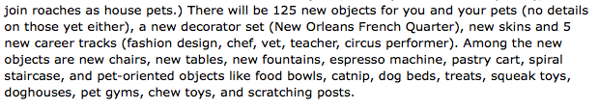
Object
Inheritance Tree
Person
Teacher
Circus Performer
Student
Pomonan?
Pasadena Institute of
Technology Student
Pomonian?
Mudder
Things to keep in mind!
Eastie
a Eastie is a Person…
"everything" is an Object…
Notes:
Something about Pomoner just doesn't sound right…

Slide 28
Hw 6, Part 2: the SpamMaze class
… inheriting from the Maze class
Object
data members
methods
maze
multiBFS
Maze
toString
constructors…
SpamMaze

Slide 29
Hw 6, Part 2: the SpamMaze class
… inheriting from the Maze class
Object
data members
methods
maze
multiBFS
Maze
toString
constructors…
addSpam
spamCells
removeSpam
SpamMaze
advancePede
pedeCells
reversePede
What types should spamCells and pedeCells be?

Slide 30
Visualizing spamCells and pedeCells
*
*
*
*
*
*
*
*
*
*
*
*
*
*
*
*
*
*
*
*
*
*
*
*
*
*
P
P
P
*
P
P
P
*
P
D
P
P
P
P
P
P
P
*
P
P
P
P
D
*
P
S
D
*
P
*
P
*
P
D
D
*
P
*
P
What should their data structures be?
Notes:
Java's libraries are comprehensive and huge… [POSTER] – two versions ago
We don't teach them explicitly, actually, but it's always good to keep in mind that they're there…
story about balance (Lenovo's Mr. Challener)

Slide 31
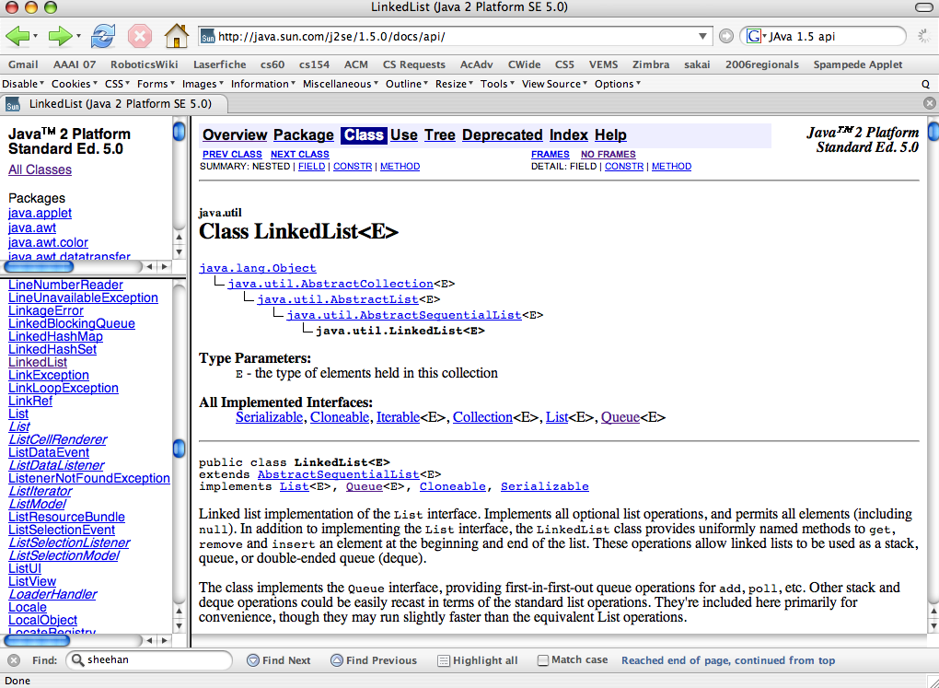
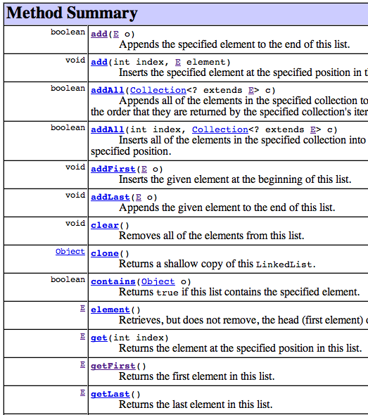
That is, have someone else write the software?
Reuse!
packages
individual classes
inheritance hierarchy
import java.util.LinkedList;
EEEEk! What is going on here?!
methods
http://java.sun.com/j2se/1.5.0/docs/api/

Slide 32
<Parameterized> Types
Many languages offer containers that can hold elements of any single type…
Early versions of Java used Objects, polymorphism, and lots of casting so that its container classes (OpenList, Queue, etc.) could hold any type of element.
I only use double-ended stacks!
Now, many containers have a type parameter to indicate what it holds:
LinkedList<MazeCell> pedeCells;
angle brackets indicate the type of Object being held in the container
Hooray!!
pedeCells.addFirst(maze[1][2]);
pedeCells.addLast(maze[1][1]);
Something feels missing here!!?!
MazeCell head = pedeCells.getFirst();
Java's LinkedList is a double-ended queue or deque datatype.
Notes:
What's missing is the cast!!! Hooray!
No more classCastExceptions!

Slide 33
Stacking the deque
Double-ended queues? I only use double-ended stacks!
A double-ended queue can add and remove elements from the front OR the back…
LinkedList<MazeCell> spamCells =
new LinkedList<MazeCell>();
what's going on here?
it's a crazy name, but it's a type just like all of Java's others…
what kind of INTERNAL list cells will this data structure have to have?

Slide 34
Stacking the deque
A double-ended queue can add and remove elements from the front OR the back…
LinkedList<MazeCell> spamCells
first
prev
data
next
[12,1]
[11,1]
DCell
last
P P … P
[12,1]
S
D
P
P
D
[15,4]
P
[15,4]
DCell
D
D
[6,4]
[6,4]
What kind of list should spamCells emulate?
[11,1]
Which will be the next spam to disappear?
Implemented via a series of doubly-linked cells (deque cells or DCells)

Slide 35
So I guess pedeCells are just queuedCells?
Moving the centipede
Moving
Eating
Breaking?!
How might a double-ended queue update the centipede, too?
updatePede(char dir)
*
*
*
*
*
*
*
*
*
*
*
*
*
*
*
*
*
*
*
*
*
*
*
*
*
*
P
P
P
*
P
P
P
*
P
D
P
P
P
P
P
P
P
*
P
P
P
P
D
*
P
S
D
*
P
*
P
*
P
D
D
*
P
*
P
LinkedList<MazeCell> pedeCells;

Slide 36
Inheritance Reminders
Models the kind-of or is-a relationship
Uses the keyword extends to indicate a base class
Only add new data members -- the old ones are already there
The keyword super calls the base class’s constructor or methods
Overriding functions have the same signature as in the base class -- only override if a new implementation is needed.
Watch out for casting/compiling issues...

Slide 37
instanceof
Base classes
Object
Person P = new Person(…);
Student S = new Student(…);
Object Ob;
Ob = P;
if (Ob instanceof Person) { print(“GO”); }
if (Ob instanceof Student) { print(“NE”); }
if (Ob instanceof String) { print(“TO”); }
Ob = S;
if (Ob instanceof Person) { print(“OD”); }
if (Ob instanceof Student) { print(“LU”); }
if (Ob instanceof Stack) { print(“WA”); }
if (Ob instanceof Object) { print(“CK”); }
Person
Student
Derived classes

Slide 38
testing… it's easier in ASCII
Run SpamMaze from the console !

